Slide 1
JAVA Loop
SAROWER AHMMED

Slide 2
What is loop in java?
Looping in programming languages is a feature which facilitates the execution of a set of instructions/functions repeatedly while some condition evaluates to true. Java loops -
While loop
Do while loop
For loop - must need to know
Advance for loop
Also can use - Switch statement

Slide 3
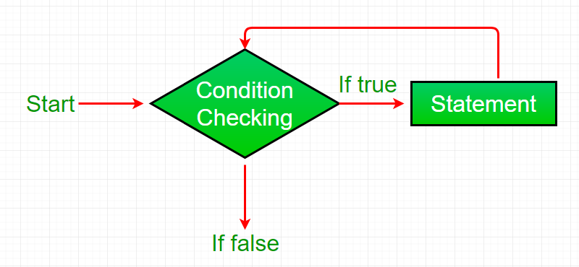
while loop:
A while loop is a control flow statement that allows code to be executed repeatedly based on a given Boolean condition. The while loop can be thought of as a repeating if statement.
Syntax :
while (boolean condition)
{
loop statements...
Break;
}

Slide 4
Try it on Eclipse
// Java program to illustrate while loop
class whileLoopDemo
{
public static void main(String args[])
{
int x = 1;
// Exit when x becomes greater than 4
while (x < 4)
{
System.out.println("Value of x:" + x);
// Increment the value of x for
// next iteration
x++;
}
}
}

Slide 5
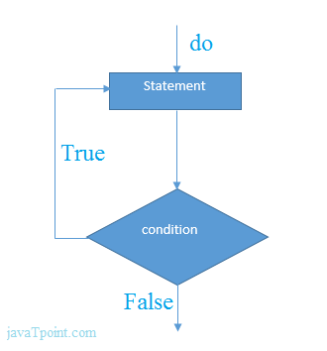
Java do-while Loop
The Java do-while loop is used to iterate a part of the program several times. If the number of iteration is not fixed and you must have to execute the loop at least once, it is recommended to use do-while loop.
The Java do-while loop is executed at least once because condition is checked after loop body.
Syntax:
do{
//code to be executed
}while(condition);

Slide 6
Try it in eclipse
public class DoWhileExample {
public static void main(String[] args) {
int i=1;
do{
System.out.println(i);
i++;
}while(i<=10);
}
}

Slide 7
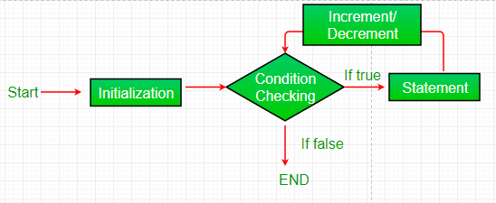
Java for loop:
for loop provides a concise way of writing the loop structure. Unlike a while loop, a for statement consumes the initialization, condition and increment/decrement in one line thereby providing a shorter, easy to debug structure of looping
Syntax:
for (initialization condition; testing condition; increment/decrement)
{
statement(s)
}

Slide 8
For loop parts
Initialization condition: Here, we initialize the variable in use. It marks the start of a for loop. An already declared variable can be used or a variable can be declared, local to loop only.
Testing Condition: It is used for testing the exit condition for a loop. It must return a boolean value. It is also an Entry Control Loop as the condition is checked prior to the execution of the loop statements.
Statement execution: Once the condition is evaluated to true, the statements in the loop body are executed.
Increment/ Decrement: It is used for updating the variable for next iteration.
Loop termination: When the condition becomes false, the loop terminates marking the end of its life cycle.

Slide 9
Try it in eclipse
class forLoopDemo
{
public static void main(String args[])
{
// for loop begins when i=2
// and runs till i <=4
for (int i = 0; i <= 4; x++)
System.out.println("Value of i:" + i);
}
}

Slide 10
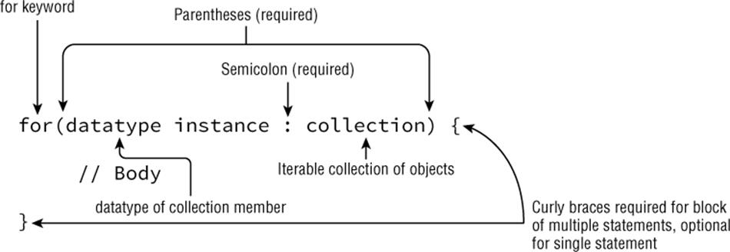
Enhanced For loop
Java also includes another version of for loop introduced in Java 5. Enhanced for loop provides a simpler way to iterate through the elements of a collection or array. It is inflexible and should be used only when there is a need to iterate through the elements in sequential manner without knowing the index of currently processed element.
Syntax:
for (DataType anyName : Collection obj/array/arrayList/list/maps/WebElement List)
{
code statement(s)
}

Slide 11
Try it in eclipse
// Java program to illustrate enhanced for loop
public class enhancedforloop
{
public static void main(String args[])
{
String array[] = {"Ron", "Harry", "Hermoine"};
//enhanced for loop
for (String x:array)
{
System.out.println(x);
}
}
}
/* for loop for same function
for (int i = 0; i < array.length; i++)
{
System.out.println(array[i]);
}
*/

Slide 12
Pitfalls of Loops- Infinite loop:
One of the most common mistakes while implementing any sort of looping is that that it may not ever exit, that is the loop runs for infinite time. This happens when the condition fails for some reason.
Examples:
//Java program to illustrate various pitfalls.
public class LooppitfallsDemo {
public static void main(String[] args) {
// infinite loop because condition is not apt
// condition should have been i>0.
for (int i = 5; i != 0; i -= 2)
{
System.out.println(i);
}
Add these code below Left part
int x = 5;
// infinite loop because update statement
// is not provided.
while (x == 5)
{
System.out.println("In the loop");
}
}
}

Slide 13
Another pitfall is that you might be adding something into you collection object through loop and you can run out of memory. If you try and execute the below program, after some time, out of memory exception will be thrown.
//Java program for out of memory exception.
import java.util.ArrayList;
public class Integer1
{
public static void main(String[] args)
{
ArrayList<Integer> ar = new ArrayList<>();
for (int i = 0; i < Integer.MAX_VALUE; i++)
{
ar.add(i);
}
}
}

Slide 14
How to break out of any loop in java
Use the word - break

Slide 15
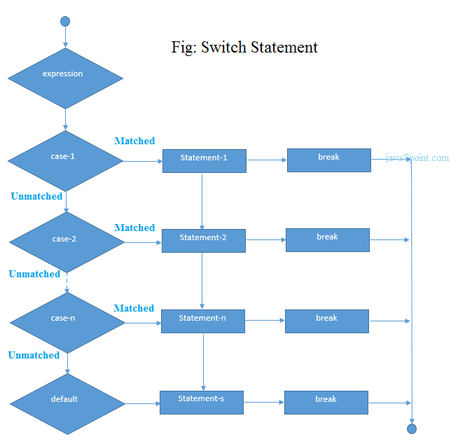
Switch statement

Slide 16
Enum Types
An enum type is a special data type
they are constants
enum type by using the enum keyword
the names of an enum type's fields are in uppercase letters.
public enum Day {
SUNDAY, MONDAY, TUESDAY, WEDNESDAY,
THURSDAY, FRIDAY, SATURDAY
}

Slide 17
public class CheckEnum {
public enum Day {
SUNDAY, MONDAY, TUESDAY, WEDNESDAY,
THURSDAY, FRIDAY, SATURDAY
}
public static void main(String[] args) {
Day day = null;
day= day.MONDAY;
switch (day) {
case MONDAY:
System.out.println("Mondays are bad.");
break;
case FRIDAY:
System.out.println("Fridays are better.");
break;
case SATURDAY:
case SUNDAY:
System.out.println("Weekends are best.");
break;
default:
System.out.println("Midweek days are so-so.");
break;
}
}
}

Slide 18
Scanner
It’s a class in java
Java default util pacage
Use : user input box

Slide 19
Enum-Switch-Scanner
public class CheckEnum {
public enum Day {
SUNDAY, MONDAY, TUESDAY, WEDNESDAY,
THURSDAY, FRIDAY, SATURDAY
}
public static void main(String[] args) {
Scanner scanner = new Scanner(System.in);
System.out.println("Please enter your day name");
Day day = Day.valueOf(scanner.nextLine());
switch (day) {
case MONDAY:
System.out.println("Mondays are bad.");
break;
case FRIDAY:
System.out.println("Fridays are better.");
break;
case SATURDAY:
case SUNDAY:
System.out.println("Weekends are best.");
break;
default:
System.out.println("Midweek days are so-so.");
break;
}
scanner.close();
}
}

Slide 20
Must need to know these for work
THANKS ALL

